Slide 1

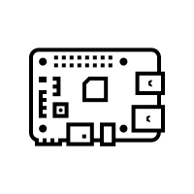
backup_pi5.sh
arch-griffix
Pi5
Docker stop
Home directory
/home/griffix
Docker config
/config
backup.sh
photos
/media/Seagate
Docker start
backup
/mnt/data/backups
backup
/media/Seagate/backups

Slide 2
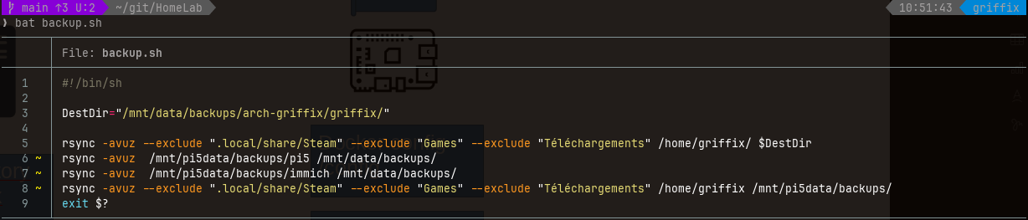
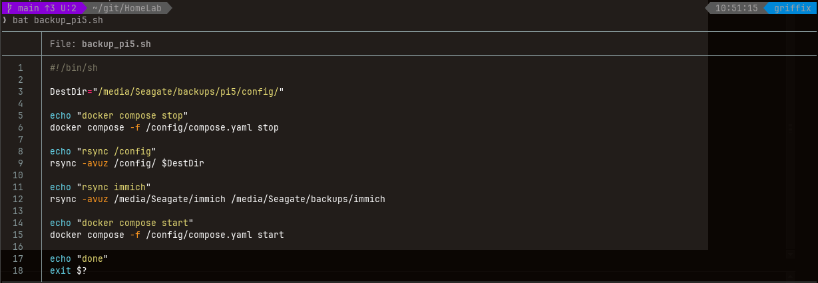
arch-griffix
Pi5

